Slide 1
deSPI: efficient classification of metagenomic reads with lightweight de Bruijn graph-based reference indexing
Dengfeng Guan
2018.12.04 IEEE BIBM 2018
Notes:
today I am gonna present a metagenomic tool I developed, deSPI, it is based on de Bruijin graph and FM-index index, It can label short metagenomics reads in a realitively fast speed with an afforable memory consumption on laptops or workstations . while it can maintain a comparable or usally better classification accuracy.

Slide 2
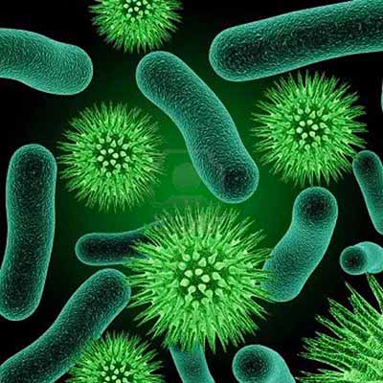
Background
Metagenomics Profiling
Classify
Assemble
Species Discovery
Notes:
first, let’s see what metagenomics is, metagenomics is the study of genactietic material recovered directly from environmental samples.
we collect samples from river, human body, forests. The samples contain millions of micriobal orgnisms. then we sequence the samples with mordern sequencing technlogy. we can get millions of reads which are from different organisms. we can classify these reads to analyze the compositon of environmental community, do abundance estimation, do GWAS. we can also assemble the reads to discover new species there. there are also many other applications I won’t mention here. my work is designing an efficient tool to classify metagenomics reads. many of you may ask why.

Slide 3
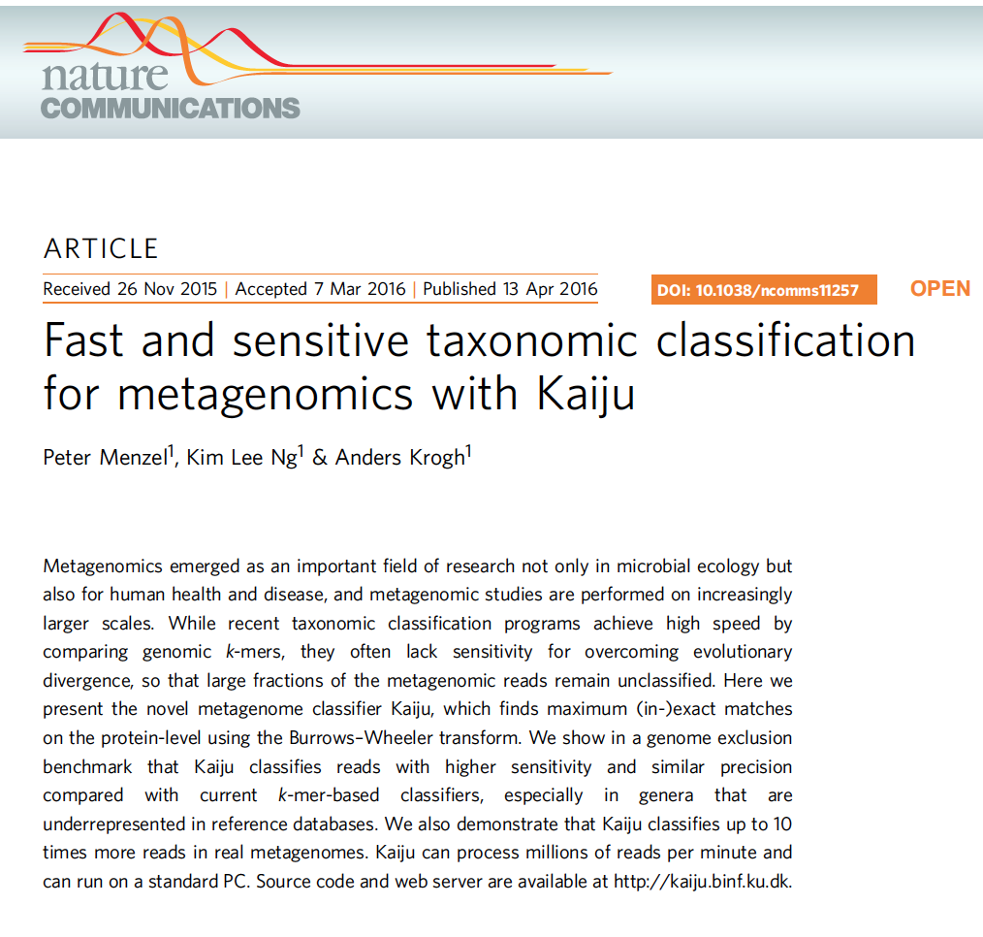

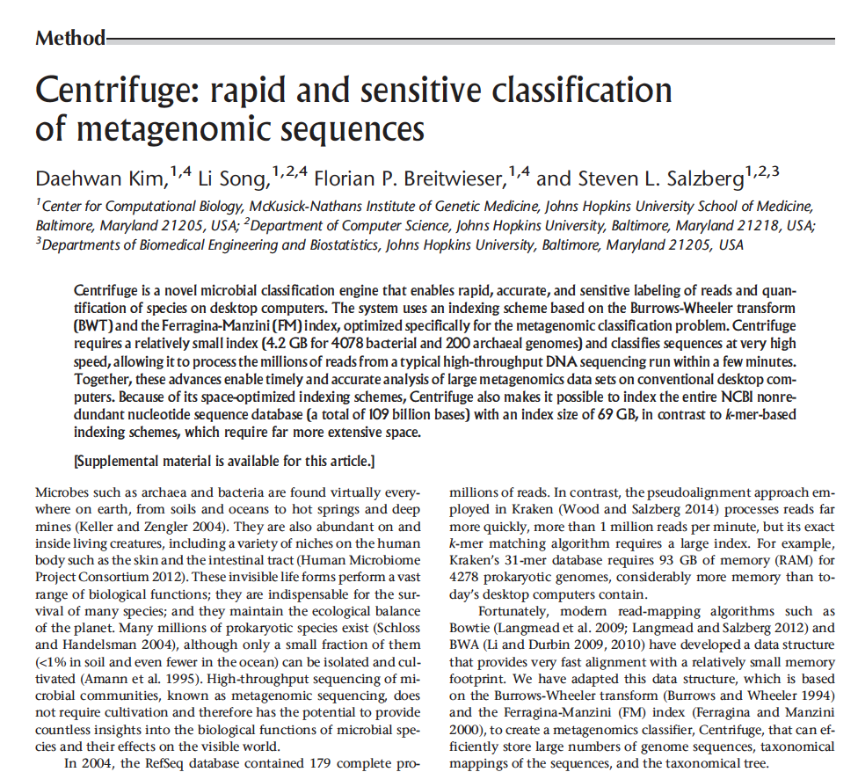
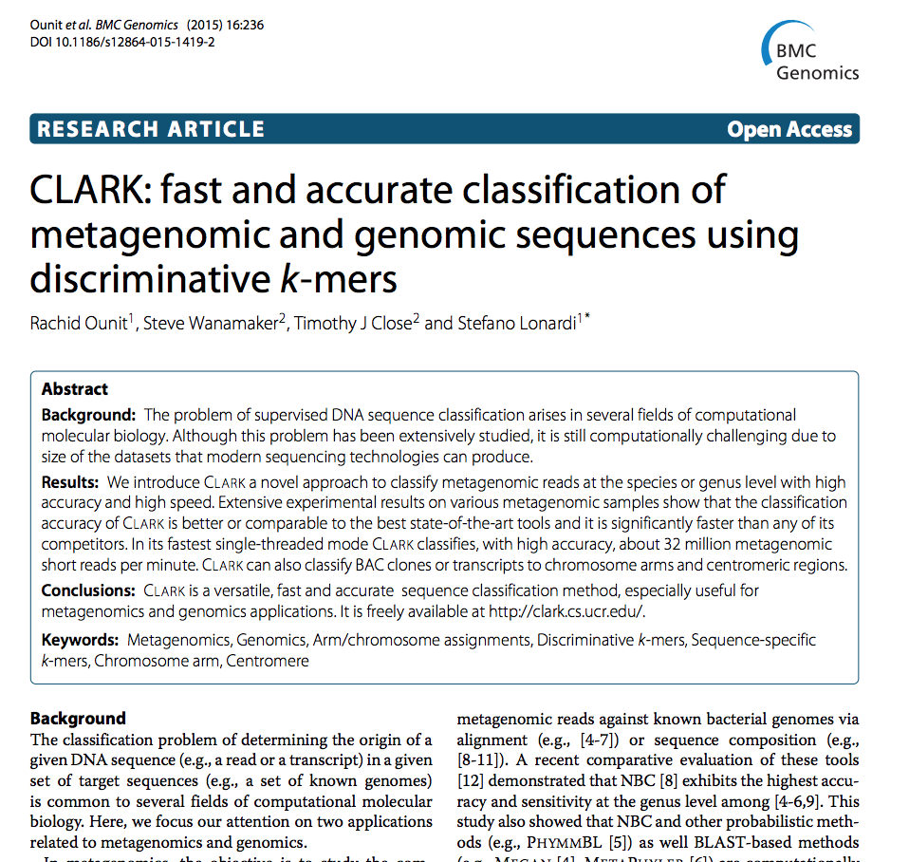
Related Work
Metagenomics Classification Tools
Notes:
in recent years, many supervised metagenomics classifiication tool have come out, here I list the 4 most widely used ones I think. they are are kraken, kaiju, clark and centrifuge. kraken and clark are kmer index based methods, while kaiju and centrifuge are fm-index based methods.

Slide 4
Related Work
Metagenomics Classification Tools
Speed
Clark
deSPI
Kraken
Centrifuge
Kaiju
Memory
Notes:
these tools have advantages and disadvantages. For kmer based index methods clark and kraken they usally take a large memory to run that’s maybe not good, however their classification speed is high. while centiruge use much less memory however their classification speed is also lower. we are aiming to develop an tool that can use much less memory usage than clark and kraken while mainting a high classification speed. here comes deSPI.

Slide 5
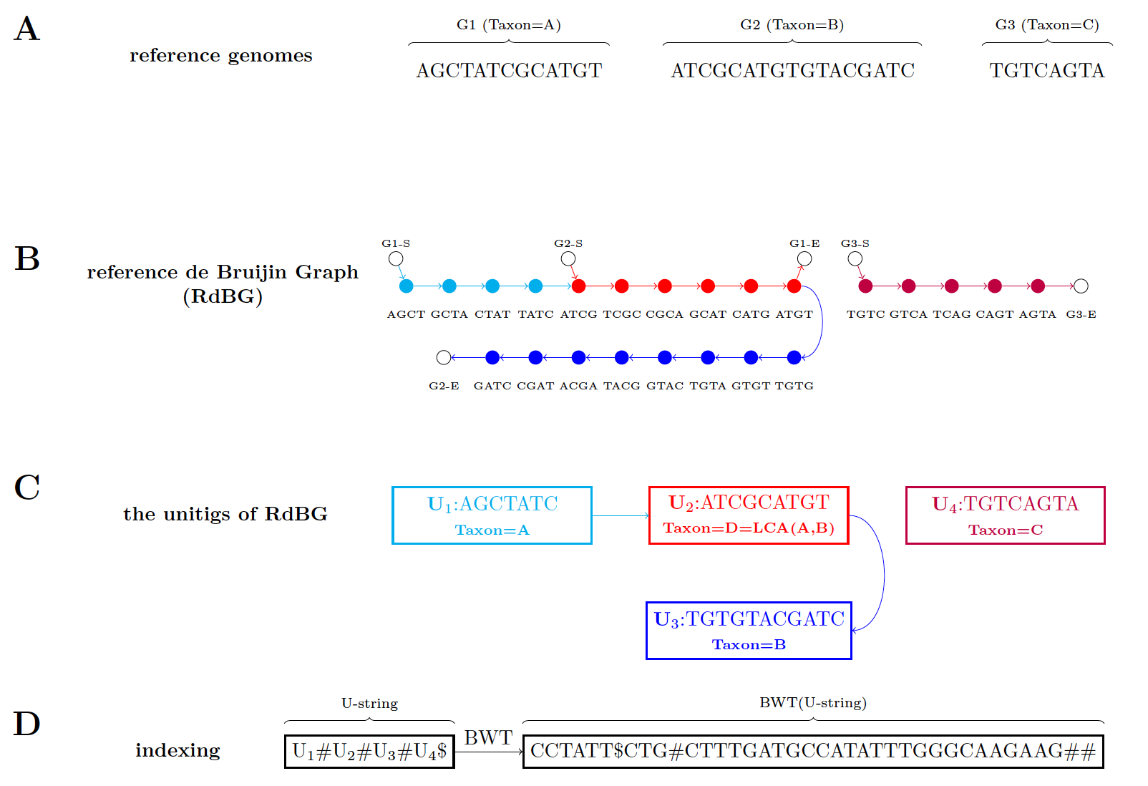
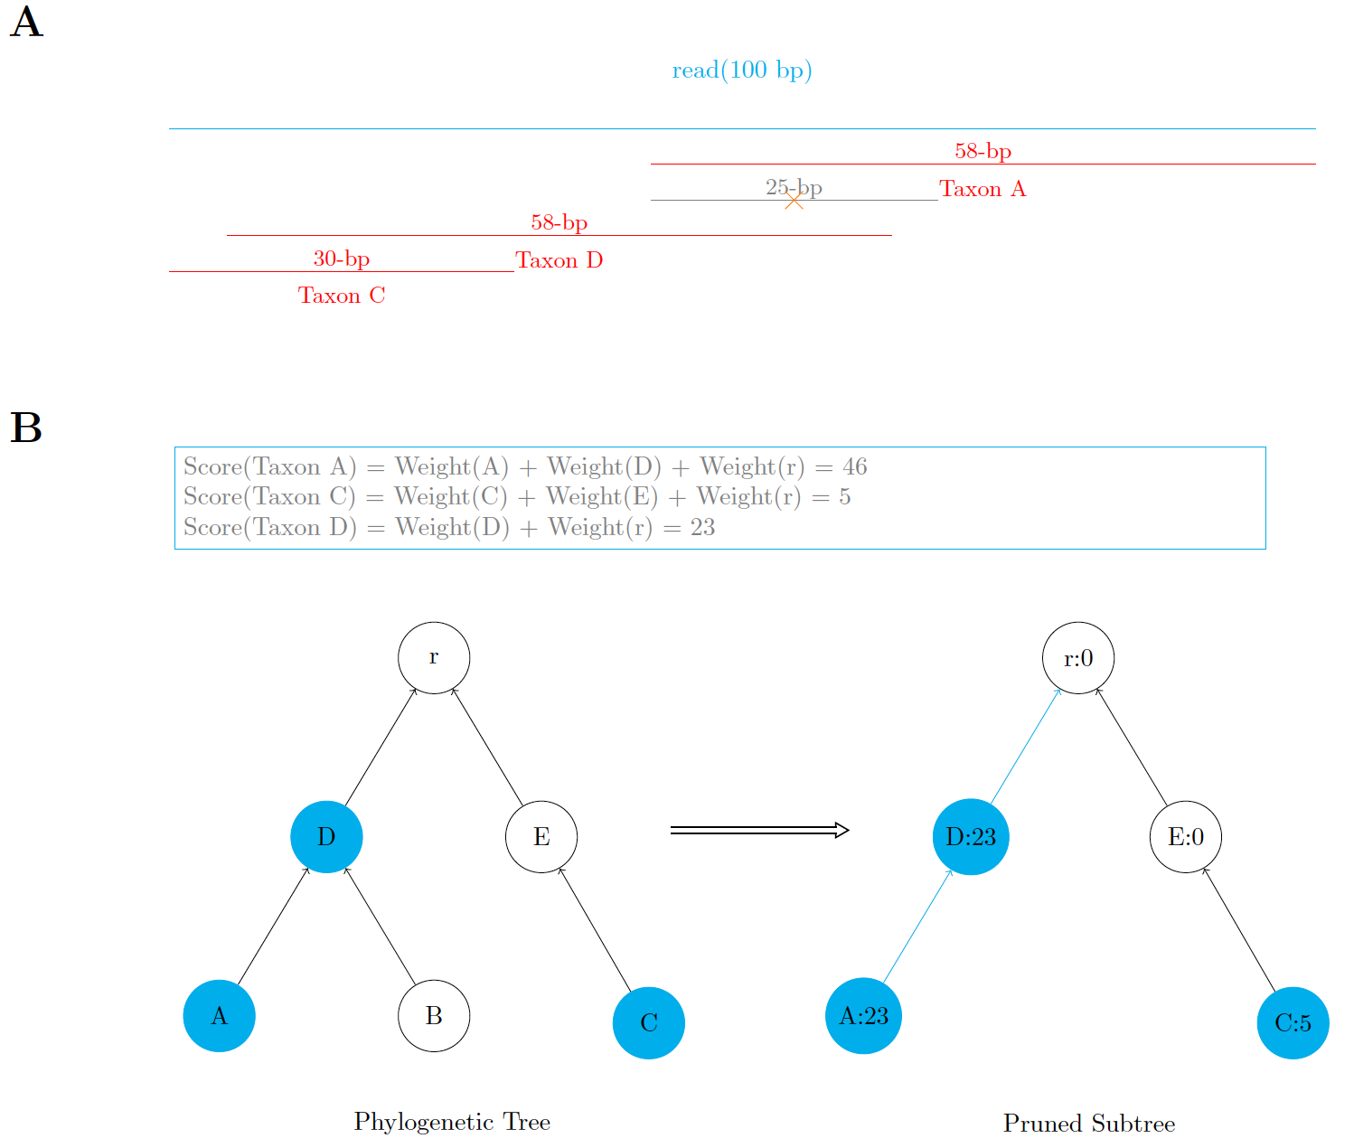
Methods
1. Indexing
2. Classifying
Notes:
deSPI workflow has two steps, step 1. indexing: deSPI builds a FM-index of the unitigs of the reference debruijin graph. step2 classifying. deSPI applys a top-down hierachal taxonomic classification method to label the reads.

Slide 6
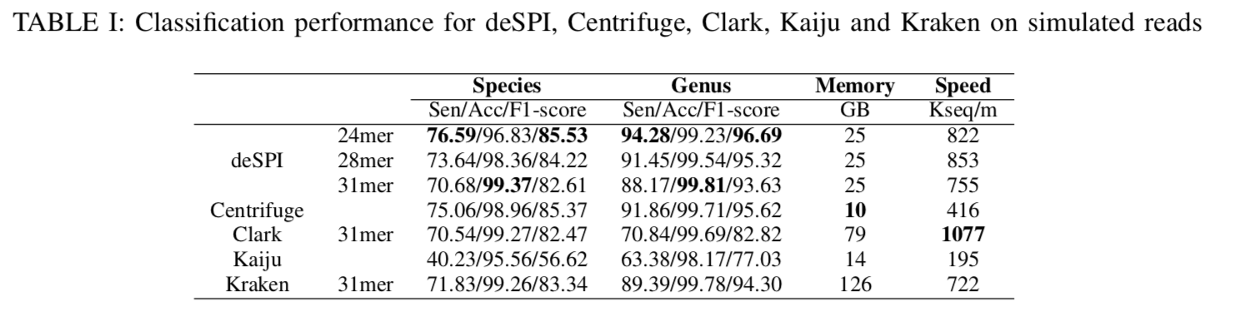
Results
Result on simulated dataset
References : 12,274 complete RefSeq genomes, including 5,975 bacterial, 219 archaea and 6,080 viral genomes (~12GB).
Dataset : 20 million simulated reads, 3% error rate.
Platform : 1 Terabytes machine with 8 Intel Xeon E7-4820 CPUs.
Notes:
here we did three experiments to test the feastilty of deSPI, and compare the classifcaiton perfromance with the four tools I mentioned earlier. One expreiment is made on simulated dataset, one is made on real sequencing datasets for individuals. another one is made on real metagenomics reads. we compare classification accuracy both at species and genus level. sensitivity here is defined as the ratio of correctly classifed reads to the number of total reads, accuracy is defined as the ratio of the number of correctly classified reads to the correclty classified reads number plus incorrectly classified, F1-score is calculated as harmonic average of accuracy and sensitvity. as we can tell from the table, clark runs the fastest, centirfuge has the leats memory consumption, deSPI has the best overall performance both at species and genus level when its seed length is 24. centrifuge has a closed classification accuracy as deSPI, kaiju has a low classification sensitivity, that’s because it often lables reads to a higher rank.

Slide 7
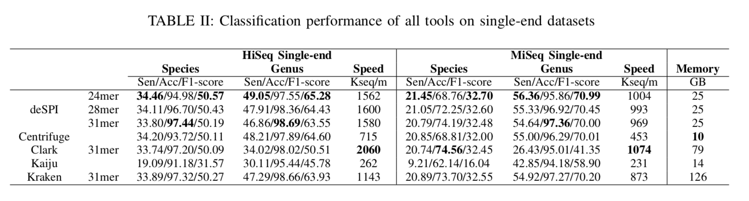
Results
Results on real datasets for individuals
References : 12,274 complete RefSeq genomes, including 5,975 bacterial, 219 archaea and 6,080 viral genomes.
Datasets : 10 HiSeq single-end datasets (28,475,681 reads in total), and 25 MiSeq single-end datasets (14,574,224 reads in total).
Platform : 1 Terabytes machine with 8 Intel Xeon E7-4820 CPUs.
Notes:
this is the results on real datas for inviduals, the table showed here is classification peformance of all tools all single-end datasets. The reference we used here is the same as we used for simulation dataset test. The test datasets contains 10 HiSeq single-end datasets of 28 million reads and 25 single-end dataset of 14 million reads. The test is performed on 1 Terabytes machine with 8 intel xeon cpus. As we can see from the table. clark still runs the fastest. while deSPI is still the best runner-up. deSPI shows the best overall peformance both at species and genus level for both datasets.when seed length is 24. Clark has the best classifcaiton accuracy at species level however a very low sensitiivity at genus level for miseq singe-end dataset. that’s because the default mode of clark only loads half of its index into memory, it fails classify as many reads as the other tools, even though it can label them confidently.

Slide 8
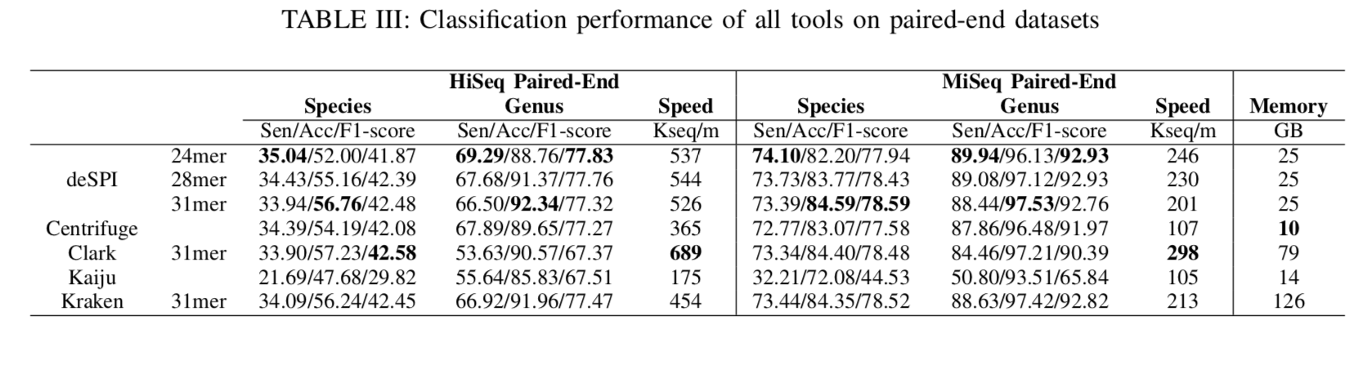
Results
Results on real datasets for individuals
References : 12,274 complete RefSeq genomes, including 5,975 bacterial, 219 archaea and 6,080 viral genomes.
Datasets : 222 HiSeq paired-end datasets (224,516,062 read pairs in total), 297 MiSeq paired-end datasets (327,824,527 read pairs in total).
Platform : 1 Terabytes machine with 8 Intel Xeon E7-4820 CPUs.
Notes:
this table show the classification peformance of all tools on pair-end datasets, same reference set was applied, 222 hiseq pair-ednd datasets of 224 m read pairs and 297 miseq-pair-end read datasets are involved in the test. as we can see from the table, all programs explore a lower classificaton speed than before, even though clark and deSPI are still two fastest. deSPI has the best overall peformance at genus level for both hiseq and miseq paired-end datasets. clark has the best overall performance at species level for hiseq-paired-end reads, however the lowest F1-score than all the tools at genus level for the same reason I mentioned erarlier. deSPI has the best overall performance at species level for miseq-pari-end with a seed length of 31.

Slide 9
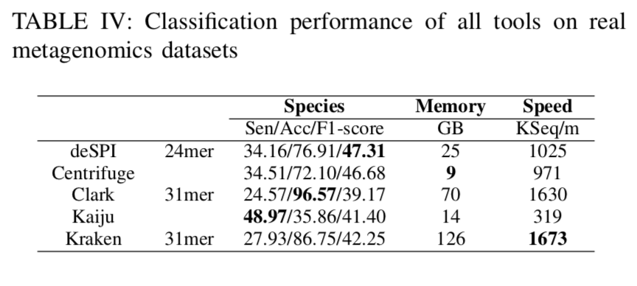
Results
Results on real metagenomics datasets
References : 6,194 complete RefSeq genomes, including 5,975 bacterial, 219 archaea.
Datasets : 11 real human gut metagenomics datasets.
Platform : 767.8 GB machine with 56 Intel Xeon E5-2690 CPUs.
Notes:
we also did a test on real dataset, with using 11 real human gut metagenomics datasets, the reference set excluded virus genomes. the test is performed on 767.8 GB machine with 56 intel xeon cpus. since we lack ground truth set for real metagenomics dataset. we first mapped reads with megablast, and choose the taxon of reads best alignment as their labels, sensitivity here is calculated as ratio of the number of classified reads to the number of total reads and the accuracy is calculated by the number of correctly classified reads to the nunber of classified reads. here we can see kraken and clark become the two fastest ones. and deSPI still has the best overall performance.

Slide 10
Takeaways
We recommend users to choose smaller seed length when there are more unknown genomes in the dataset, and choose larger seed length to more accurately recognize known genomes within the dataset.
deSPI also provides a function called “view” to print all the unitigs or unitigs to a specific taxon.
Notes:
avaliablity: slide github

Slide 11


Acknowledgment
Bo Liu
Yadong Wang
Richard Durbin
Email: dfguan@hit.edu.cn
Github: https://github.com/dfguan

Slide 12
Methods
Indexing
Notes:
deSPI workflow contains two steps . step 1. indexing, step 2. classification. in the indexing phase, it construct an FM-index of unitigs of references debruijin graph. Let’s take a look at it. give a reference set, deSPI construct each unitig is labeled by a taxon of the lowest common ancestor of the species contiaing that unitig.

Slide 13
Methods
Classifying
Notes:
given a read and a minimum seed length, we perform largest exact match search backwardly over the FM-index. here in this example, the minimum exact match length is 25, after we peform the serach, we can find 4 largest exact matches. one of 25bp is remove because it is not larger than the minimum exact match length. each match will correspond to a taxon, each taxon is a node in the evolutionary tree, and each node is weighted by the the exact match length minius minimum exact match length. after we get all nodes with hits and their weights. we can define a pruned subtree from phylogetic tree, which includes … then we calcuate accumulated weights from each root to leaf path as score, the path with maximum score is the classification path and its leaf node is the lable of the given read.

Slide 14
Background
Metagenomics Data Size
Microbiome Projects
UK: Gut Project
US: Integrative Human Microbiome Project
2014
2010
Earth Microbiome Project
US: The Human
Microbiome Project
2007
Notes:
The answer is this work is still a burden. with
Before 2008, there are almost no metagenomics sequencing data.
From 2014, metagenomics sequencing data size grows faster, in a 6 years period, the data size
2014 British Gut Project: aim to explain the importance of microbes for our overall well being
2010 The primary goal of the Earth Microbiome Project (EMP) has been to survey microbial composition in many environments across the planet, across time as well as space, using a standard set of protocols

Slide 15
Related Work
Metagenomics Classification Tools
Speed
Clark
Engineª | Memory (GB) | Speed (Kseq/m)
Kraken | 126 | 722
Clark | 75 | 1077
Centrifuge | 10 | 416
Kaiju | 14 | 195
deSPI
Kraken
Centrifuge
Kaiju
Memory
a: statistics collected from the test on simulated datasets
Notes:
these tools have advantages and disadvantages. For kmer based index methods clark and kraken they usally take a large memory to run that’s maybe not good, however their classification speed is high. while centiruge use much less memory however their classification speed is also lower. we are aiming to develop an tool that can use much less memory usage than clark and kraken while mainting a high classification speed. here comes deSPI. It indexes the

